Slide 1
DATA 300: Statistical Machine Learning
Linear Regression: Potential problems

Slide 2
Agenda
Potential problems with linear regression
Identify non-linearity in the data
Uncorrelated error terms
Collinearity
Train-test split

Slide 3
Identify non-linearity in data
Given “model” as the generated linear regression model in R, plot(model) gives a residual-fitted value plot.
A plot with obvious pattern would indicate non-linearity.

Slide 4
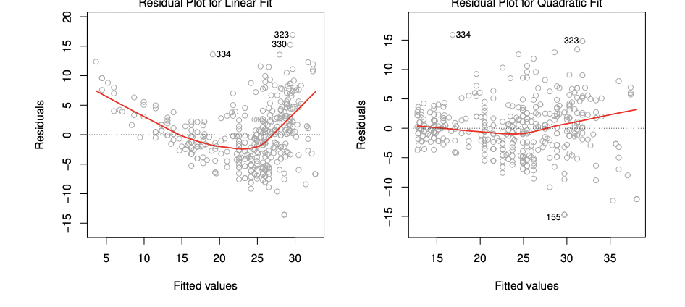
Identify non-linearity in data
Given “model” as the generated linear regression model in R, plot(model) gives a residual-fitted value plot.
A plot with obvious pattern would indicate non-linearity (left).

Slide 5
Identify non-linearity in data
Given “model” as the generated linear regression model in R, plot(model) gives a residual-fitted value plot.
A plot with obvious pattern would indicate non-linearity (left). You usually need to investigate the cause and remove non-linearity via variable permutation.

Slide 6

Error terms
One assumption in linear regression is the independent of error terms, i.e., model making a mistake on sample unit $i$ does not mean this model will likely make the same mistake on unit $i+1.$

Slide 7
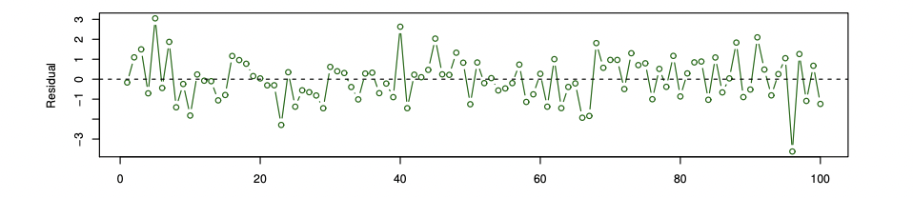
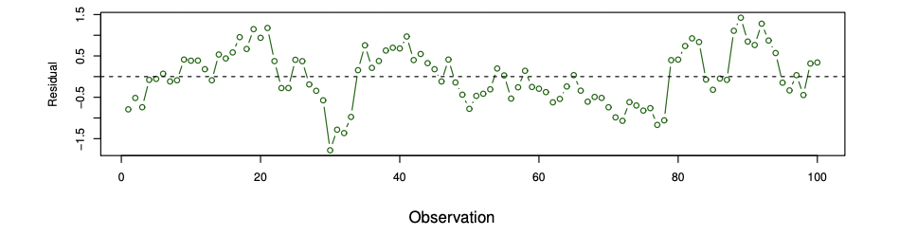
Error terms
Up: no pattern among residuals.
Down: closers sample units tend to have similar residuals. You also need to investigate the cause – either linear regression does NOT suit the dataset, or you have to remove the “similar” sample units.

Slide 8
Error terms
What would be a common scenario(s) that we can foresee a group of “nearby” sample units having similar residuals?

Slide 9
Error terms
What would be a common scenario(s) that we can foresee a group of “nearby” sample units having similar residuals?
If the dataset is, for example, stock price, where ”nearby” sample units are stock price in adjacent days. Then residuals tend to be similar for adjacent sample units.

Slide 10
Collinearity
Collinearity refers to two variables strongly relating to each other.

Slide 11
Collinearity
Collinearity refers to two variables strongly relating to each other. This is different from interaction.
Price = bedroom + bathroom + bedroom*bathroom means factoring the combination of bedroom and bathroom (interaction) helps predict price.
Credit = limit + rating, on the other hand, is saying limit and rating have an impact on each other (collinearity). Higher limit always corresponds to higher rating.

Slide 12
Brainstorming
If you have to build another linear regression model to identify the variables that are highly related to each other, how do you design it?

Slide 13
Brainstorming
If you have to build another linear regression model to identify the variables that are highly related to each other, how do you design it?
Use variable j as the response, and all other independent variables as predictors.
If you get a good fit (high R-squared), this variable j is highly associated with the rest of the variables.

Slide 14

Collinearity
Collinearity refers to two variables strongly relating to each other. Variational inflation factor (VIF) is the most commonly used signal for it.
VIF>5 or VIF>10 are the two common thresholds for high collinearity.

Slide 15
Agenda
Potential problems with linear regression
Identify non-linearity in the data
Uncorrelated error terms
Collinearity
Train-test split

Slide 16
Training set versus holdout set
Training set: part of the dataset used to train the model, i.e., calculate model parameters. Usually should be 80% of the dataset.

Slide 17
Training set versus holdout set
Training set: part of the dataset used to train the model, i.e., calculate model parameters. Usually should be 80% of the dataset.
Holdout set: the rest of the dataset that were NOT in the training process. Use it to test the model.

Slide 18
Brainstorming
What does it mean to have a small error on the training set, but a high error on the test set?

Slide 19
Brainstorming
What does it mean to have a small error on the training set, but a high error on the test set?
The model worked too hard to minimize the bias and resulted in high variance, i.e., performance change drastically with small changes in sample units.
Common solutions: use a less complex model, remove variables (let the model have less information on training set).

Slide 20
Linear regression summary
Goal: estimate the parameters so we could minimize the (squared) error on the training set.

Slide 21
Linear regression summary
Goal: estimate the parameters so we could minimize the (squared) error on the training set.
Model performance measures:
A small p-value for the model suggests that at least one variable is impactful.
R-squared suggests the percentage of variation in the response being explained by the model.
A small p-value for a variable suggests that this variable is likely to be impactful.
We have more confidence on an estimate if 1) we have more sample units, and 2) if the corresponding predictor is more spread out.
As much confidence as we may have, an estimate may NOT be the true value of the parameter. We could build confidence intervals to give a range for the true parameter.

Slide 22
Linear regression summary
Goal: estimate the parameters so we could minimize the (squared) error on the training set.
Model improvements:
Add an interaction term if you suspect combining two variables help explain the response.
Drop the predictors that are highly collinear.
Read the residual plot – if there is any pattern on residuals, consider add a nonlinear term.
Plot residuals for all sample units – if some sample units have similar residuals, consider a different model or drop sample units.

